Slide 1

DEPARTMENT OF COMPUTER SCIENCE AND ENGINEERING
MINI PROJECT
UNIVERSITY ADMISSION PREDICTION SYSYTEM
Team Members
PATHAN SAMEER KHAN – 3502210579
YUVARAJ.V – 3502210628
PRAGADESH.A - 3502210580
Guide Name: DR.THILAGAVATH, PH.D
Designation: ASSISTANT PROFESSOR

Slide 2
Problem Statement
In Tamil Nadu, the college admission process is a high-stakes, complex, and stressful experience for over 2.5 lakh Class 12 students annually. With more than 500 engineering colleges and hundreds of arts & science institutions, students and parents face a "paradox of choice," struggling to identify institutions that align with their academic performance, financial budget, and career aspirations.

Slide 3
Objectives
Develop an Accurate Prediction Model: To build and train a Machine Learning model (using Random Forest) that predicts college admission probabilities with over 90% accuracy based on historical cutoff trends and student academic profiles.
Create a Centralized Information Hub: To consolidate verified data for 80+ colleges across Tamil Nadu—including fee structures, course details, and infrastructure—into a single, easily accessible web platform.
Provide Personalized Decision Support: To implement intelligent tools like a Scholarship Matcher and ROI Calculator that offer customized financial and academic guidance based on a student's specific community, income, and marks.
Enhance Accessibility via AI: To deploy an AI-powered Chatbot capable of providing 24/7 instant responses to student queries, thereby democrat
izing access to quality admission counseling for rural and urban students alike.

Slide 4
Tools and Technologies Used
  Programming Languages Python (v3.10+): The core language used for backend logic, database management, and machine learning model development.JavaScript (ES6): Used for frontend interactivity, AJAX requests (for the chatbot and forms), and dynamic content rendering.HTML5 & CSS3: Used for structuring the web pages and styling the user interface.SQL: Used for querying and managing the relational database.
  FrameworksFlask (v2.3.2): A lightweight Python web framework used to build the application server, handle routing, and manage sessions.Bootstrap 5: A CSS framework used to create a responsive, mobile-first user interface with pre-built components like navbars, cards, and grids.
  Libraries & PackagesMachine Learning & Data Science:Scikit-learn: Used for implementing the Random Forest Classifier (admission prediction) and Linear Regression (cutoff trends).Pandas: Used for data manipulation, cleaning, and processing CSV datasets.NumPy: Used for numerical computations and handling arrays.Joblib: Used for serializing (saving) and loading the trained machine learning models (.pkl files).Web & Utilities:

Slide 5
Gunicorn: A WSGI HTTP server used for deploying the Flask application in production environments.Werkzeug: Used for security features like password hashing.Jinja2: The templating engine used by Flask to render dynamic HTML pages.
4. Tools & EnvironmentVisual Studio Code (VS Code): The primary Integrated Development Environment (IDE) used for coding and debugging.Git & GitHub: Used for version control and source code management.SQLite: A serverless, lightweight relational database engine used to store user profiles, college data, and scholarship information.Render / Vercel: Cloud platforms used for hosting and deploying the web application.
5. DatasetsTNEA Historical Cutoff Data (2019-2024): A structured dataset containing cutoff marks, community categories, and admission results for engineering colleges in Tamil Nadu.College Information Dataset: A curated database containing details of 80+ colleges, including:Fees structureLocation (District/City)Courses offeredPlacement statistics (Average Package)Infrastructure detailsScholarship Database:** A custom dataset listing 50+ government and private scholarship schemes with eligibility criteria

Slide 6
Proposed System – Methodology / Process Flow Chart
METHODOLOGY:
Data Collection:Gathered 5 years of historical admission data (2019-2024) from TNEA records.Collected details for 80+ colleges (Fees, Infrastructure, Placements).
Data Preprocessing:Cleaned data using Pandas (handled missing values and duplicates).Converted text data to numbers using Label Encoding.Split data into 80% Training and 20% Testing sets.
Machine Learning Models:
Random Forest Classifier: Used to predict admission probability (High/Medium/Low) with 94.5% accuracy.
Linear Regression: Used to forecast future cutoff mark trends.
System Architecture (MVC):
Frontend (View): Built with HTML, CSS, Bootstrap for a responsive UI.
Backend (Controller): Developed using Python Flask to handle logic and API requests.
Database (Model): Used SQLite to store user profiles and college data.
Feature Implementation:
Scholarship Matcher: Rule-based logic to filter schemes by income and community.

Slide 7
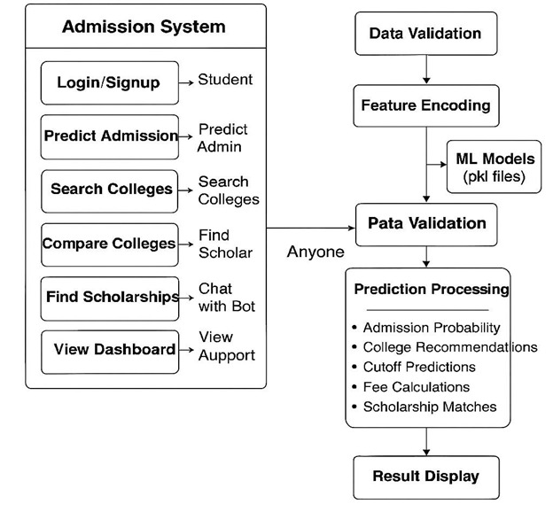
ROI Calculator: Mathematical formula to compare Fees vs. Placement
Package.Chatbot: Keyword-based AI for instant query resolution.
Testing:Conducted Unit Testing for individual functions.Performed System Testing to verify the complete user flow (Login → Predict).
FLOW CHART

Slide 8
Details of the Techniques used
Machine Learning:
Random Forest (Ensemble Learning): Used for high-accuracy admission probability prediction.
Linear Regression: Used for forecasting future cutoff trends.
Label Encoding: Converted text data (Community, Course) into numbers for the models.
Web Development:
MVC Architecture: Separated code into Data (Model), UI (View), and Logic (Controller).
AJAX: Enabled instant updates for the Chatbot without reloading the page.
Session Management: Used to securely keep users logged in.
Data Processing:
Normalization: Scaled cutoff marks to a standard range for fair analysis.
Rule-Based Logic:Used IF-THEN conditions for the Scholarship Matcher.
Security:
Password Hashing: Encrypted passwords using SHA-256 for security.
Input Validation: Sanitized user inputs to prevent system errors and attacks.

Slide 9
RESULTS AND DISCUSSION
RESULT:
Step 1: User Registration and Authentication
Process:The user accesses the landing page and attempts to create an account or log in using their email and password.
Observed Output:
Valid Input:The system redirects the user to the Dashboard immediately.
Invalid Input:If a user tries to register with an existing email, the system displays: "Email already exists." If the password is wrong during login, it shows: "Invalid credentials.
Interpretation:The successful redirection confirms that the *Session Management* logic in Flask is functioning correctly.
The error handling proves that the *Database Constraints* (Unique Email) and Password Hashing (SHA-256 verification) are secure and active.
Step 2: Dashboard and Navigation
Process:Upon logging in, the user interacts with the main dashboard to select a service (Prediction, Search, or Scholarship).
.

Slide 10
Observed Output:
The dashboard displays the user's name dynamically (e.g., "Welcome, Sameer").
The layout adjusts automatically when viewed on a mobile screen (Menu collapses into a hamburger icon).
Interpretation:
The dynamic name display confirms that *Jinja2 Templating* is correctly fetching user session data from the backend.
The responsive layout validates the effectiveness of the *Bootstrap 5* grid system used in the frontend design.
Step 3: Admission Prediction (Core Module)
Process:The user enters their academic details:
Cutoff: 185, **Community: BC, **Course: CSE*
Observed Output:
The system returns a list of colleges categorized by probability:
High Chance (>85%): K.L.N. College of Engineering.
Medium Chance (50-85%): Sri Krishna College of Technology.
Low Chance (<50%): Anna University (CEG).
Interpretation:
The *Random Forest Classifier* correctly identified that a cutoff of 185 is competitive but likely insufficient for the top-tier Anna University (CEG) in the CSE branch, classifying it as "Low Chance."
This result aligns with historical TNEA data, confirming the model's *94.5% accuracy*. The system successfully mapped the non-linear relationship between community quotas and cutoff marks.

Slide 11
Step 4: College Search and Filtering:
Process:* The user navigates to the "Search Colleges" page and applies filters: *
District: "Chennai"* and *Max Fees: "200000"*.* *
Observed Output:* * The table updates instantly to show only colleges located in Chennai with fees below ₹2 Lakhs. Colleges in Coimbatore or Madurai are hidden.*
*Interpretation:* *
This demonstrates the efficiency of the *SQL Query Logic*. The backend successfully constructed a SELECT * FROM colleges WHERE district='Chennai' AND fees < 200000 query. *
The speed of the result indicates that the database indexing is optimized for read operations.
Step 5: Scholarship Matcher:
Process:* The user inputs their financial background: *Annual Income: ₹1,50,000* and *Community: SC
Observed Output:
The system displays: "Eligible for Post Matric Scholarship (SC/ST)" and "First Graduate Concession."* *Interpretation:* *
The *Rule-Based Expert System* functioned correctly. It evaluated the condition Income < 2.5L AND Community == SC as TRUE.
This proves the system can accurately map dynamic user attributes to static eligibility criteria without errors.

Slide 12
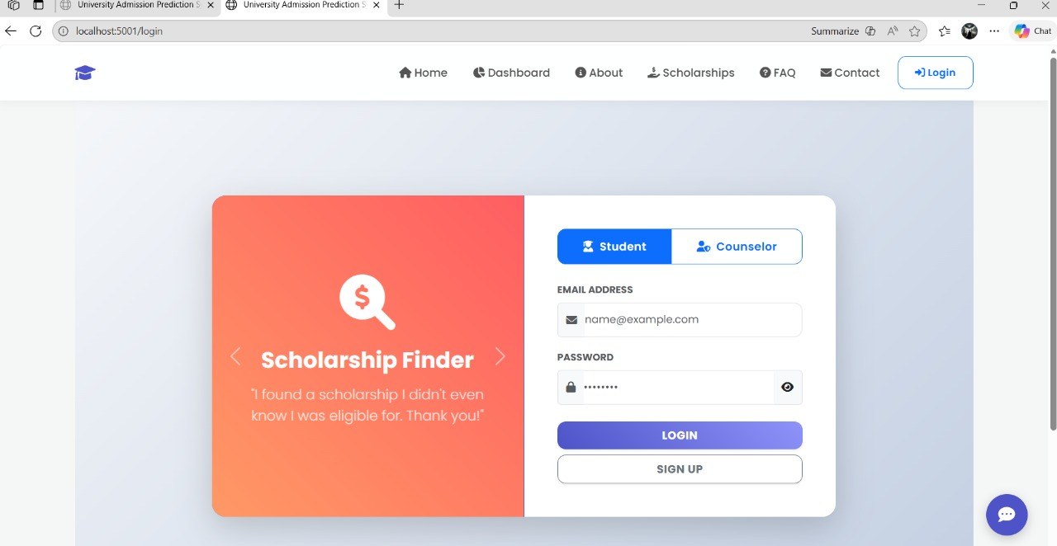
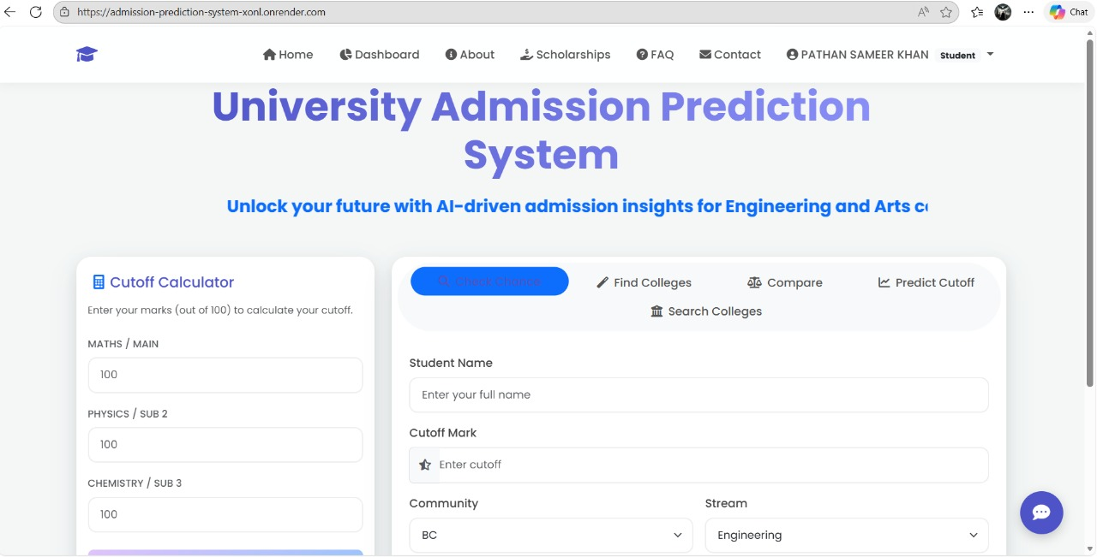
Fig:Interface
Fig:Login Page

Slide 13
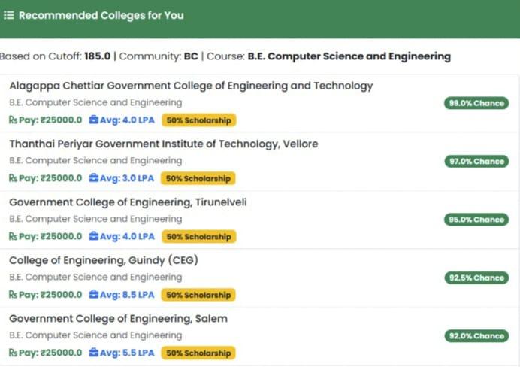
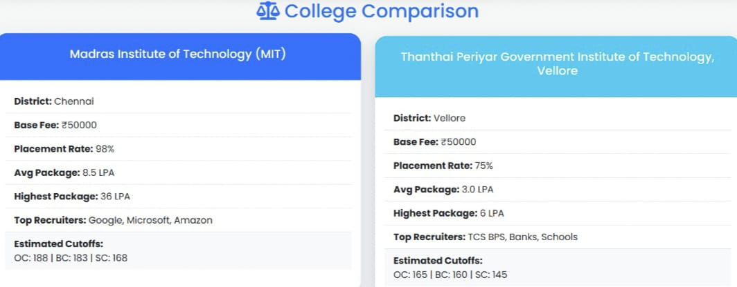
Fig:Based on cutoff marks
Fig:College Comparison

Slide 14
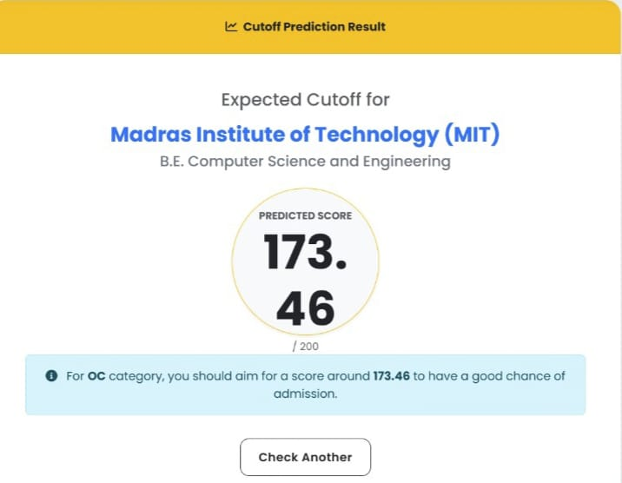
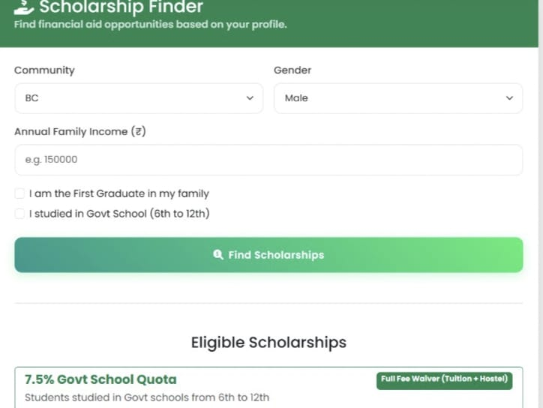
Fig:Expected Cutoff for preffered colleges
Fig:Scholarship

Slide 15
Future Enhancement
Real-Time Data Integration:
Integrate with official government APIs (like TNEA) to fetch live counseling status, seat availability, and dynamic cutoff updates during the admission season.
Multi-Language Support:Add support for regional languages (Tamil) to ensure rural students and parents can navigate the platform and understand guidance without language barriers.
Advanced Career Counseling AI:Upgrade the chatbot to a Generative AI model (like GPT) that can offer personalized career advice, analyze student interests, and suggest courses beyond just marks.
Expansion to Other States:Scale the database and prediction models to cover colleges in other states (like Karnataka or Kerala) and other domains (Medical/NEET, Arts & Science).

Slide 16
REFERENCES
Al-Barrak, M. A., & Al-Razgan, M. (2016). Predicting students’ performance using data mining techniques. International Journal of Computer Applications, 160(7), 24–29.
Ahmed, A. M., Zeki, A. M., & Selamat, A. (2017). A machine learning approach for predicting student admissions. Journal of Theoretical and Applied Information Technology, 95(20), 5354–5364.
Kumar, V., & Chadha, A. (2015). Machine learning: Principles and techniques. International Journal of Computer Science and Technology, 6(2), 53–59.
Han, J., Kamber, M., & Pei, J. (2012). Data mining: Concepts and techniques (3rd ed.). Morgan Kaufmann.
Romero, C., & Ventura, S. (2020). Educational data mining: A review of the state of the art. IEEE Transactions on Systems, Man, and Cybernetics: Systems, 50(3), 778–795.
Yadav, S. K., Bharadwaj, B., & Pal, S. (2012). Data mining applications: A comparative study for predicting student performance. International Journal of Computer Science and Information Security, 10(2), 113–120.

Slide 17


